Slide 1
Functions with Parameters
A supplemental lesson for AP CSP

Slide 2
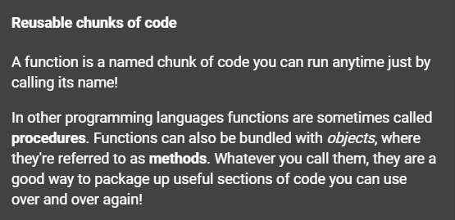
Review: Functions
Function: a named set of instructions that accomplishes a task

Slide 3
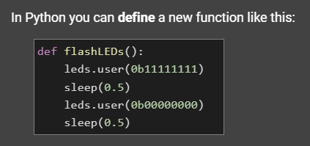
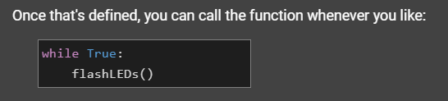
A function in Python

Slide 4
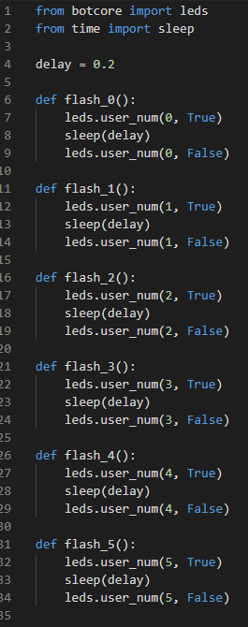
Example #1: Define a function
Open the SequenceLEDS_functions program.
Review the functions you defined for this program.
Do you notice any similarities in the code?

Slide 5
Example #1: Define a function
Each function does the same thing, just with a different LED.
Can we simplify the program even more with a single function?

Slide 6
Example #1: Add a Parameter
Since all the functions do basically the same thing, you can create ONE function and give it specific information.
In this program, the information it needs is which LED to flash.
Information given to a function is called a parameter.

Slide 7
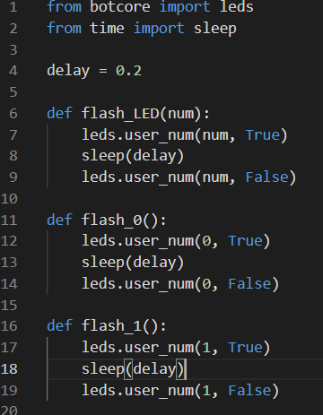
Example #1:
Function with Parameter
Create a new function, and add a parameter for which LED to flash.
The parameter will be a variable inside the function.
It needs to have a descriptive name to remind you what its purpose is.
Use the parameter in the function as a variable.

Slide 8
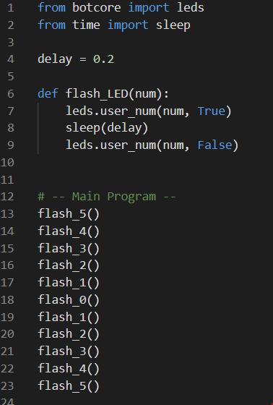
Example #1:
Function with Parameter
Now you can delete all the other functions, and just call the one function with a parameter.

Slide 9
Example #1:
Function with Parameter
You will need to change your function calls to add the information the function needs.
The information you give in a function call is called an argument.
The value of the argument is “passed” to the parameter.

Slide 10
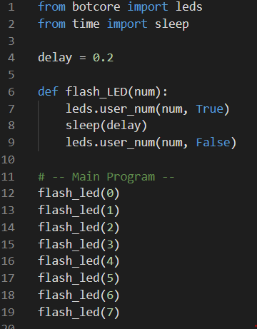
Example #1: Call a Function with Parameter
Function call with argument.
The value in ( ) is the argument.
It gets “passed” to the parameter.
Then the value of the parameter is used in the function.

Slide 11
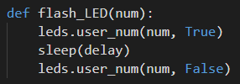

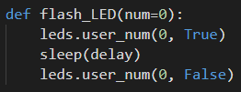
Example #1: Call a function with a parameter
Example: What happens:
Function Call:
And has the effect:

Slide 12
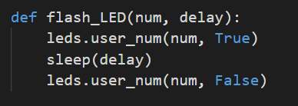
Example #1: More than one parameter
Maybe you want to change the speed of the flashing light.
It doesn’t always have to be the same delay.
A function can have more than one parameter.
Add a delay parameter to your function definition.

Slide 13
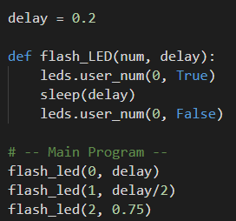
Example #1: More than one parameter
When you call this function, you will need to include two arguments.
The arguments MUST be in the same order as the parameters.
An argument can be a variable, or a literal number.

Slide 14
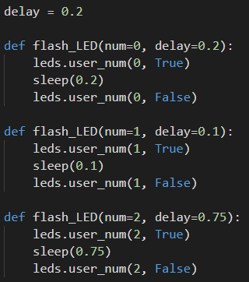
Example #1: More than one parameter
This code: has this affect:

Slide 15
Example #1: Modify your code
Modify your code in SequenceLEDs_functions:
Have two parameters: num and delay
Use the parameters in the function definition
In the Main Program, call the function several times, using two arguments each time
Run the code without any errors
Create an amazing light show!

Slide 16
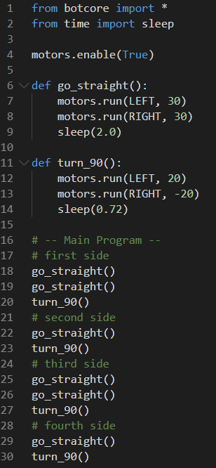
Example #2: NavSquare
Open your NavSquare_functions code.
It may look like similar to this, but it could be different.
Do you see some information in the functions that could be parameters?

Slide 17
Example #2: NavSquare
Look at the go_straight() function.
The speed of the wheels can be a parameter.
The amount of delay can be a parameter.
This will let you drive the ‘bot in a straight line at a variable speed for a variable amount of time.

Slide 18

Example #2: NavSquare
Add two parameters to the go_straight() function.
Parameters need to have descriptive names.
Use the parameters inside the function as variables.

Slide 19
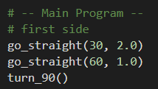
Example #2: NavSquare
Modify the function calls to add two arguments.
Remember to put the arguments in the same order as the parameters.
You will need to add arguments to all the go_straight() function calls.
You may not get a square!

Slide 20
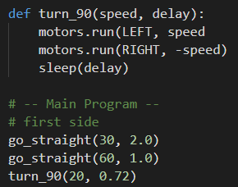
Example #2: NavSquare
Now add the same parameters to turn_90()
You can use speed and delay as parameters.
Modify the all function calls to include two arguments.
You may not always get a 90 degree angle turn, but that is okay.

Slide 21
Challenge
Another program you created in Mission 3 is BinaryLEDs
For a challenge, add a parameter to the function for this program.

Slide 22
Wrap-up
Functions with Parameters
Submit your two programs to the teacher:
SequenceLEDs_functions
NavSquare_functions

Slide 23
Answer these questions:
In your own words, what is a parameter?
Give an example of a parameter.
In your own words, what is an argument?
Give an example of an argument.
What is an advantage of using parameters and arguments with functions?
NOTE: Moving forward, you will be required to use functions in your code, even when CodeTrek does not tell you to.

